Slide 1
Percentage SkillS - GST
Year 11 Essentials

Slide 2

Learning Intentions
At the end of the lesson you should be able to
Calculate the final price of a product of service with GST added
Calculate the GST component from a total price of a product of service
WICOR

Slide 3
brainstorm
With a partner:
What is the GST?
How much is GST in Australia?
What is not charged GST?
WICOR
Notes:
GST Free sales in Australia https://www.ato.gov.au/Business/GST/When-to-charge-GST-(and-when-not-to)/GST-free-sales/

Slide 4
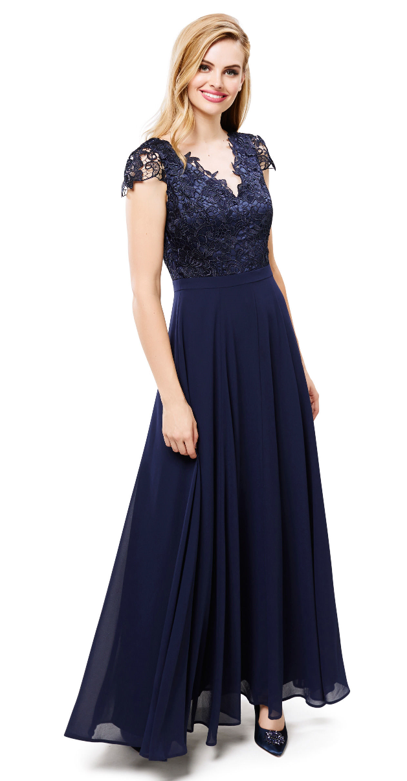
24
7
30
Application of Percentage Skills
Date: 27/08/2018
EQ – How is GST applied in Australia?
What is the GST?
The Goods and Services Tax, (GST), in Australia is at a rate of 10% and is applied to all goods and services except for those categorised as essential items.
Example
Miss Lum has chosen the dress that her bridesmaids will be wearing. Its retail price is $199 excluding GST.
What will be the full price of the dress including GST?
How do we calculate the GST that needs to be added?

Slide 5
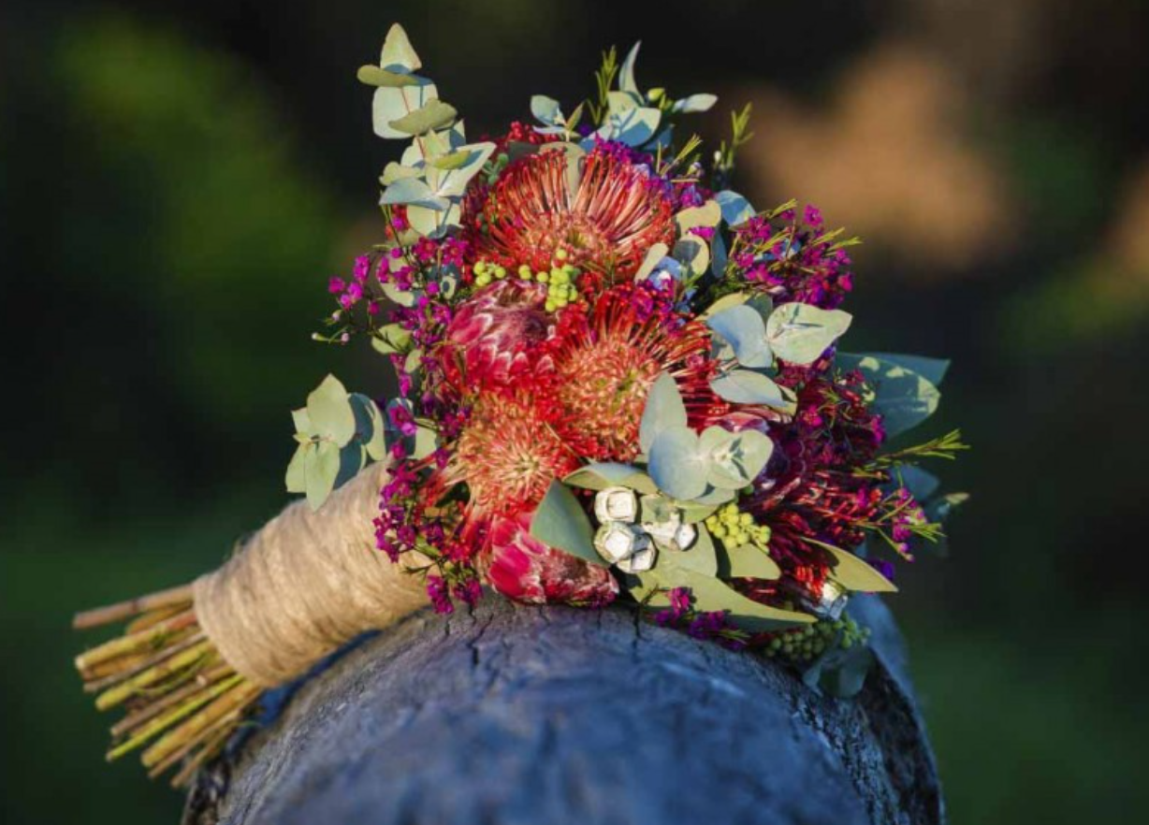
24
7
30
Application of Percentage Skills
Date: 27/08/2018
EQ – How is GST applied in Australia?
How do we calculate the GST component of a price?
Example
Miss Lum and her fiancé have decided on the flowers that will be used in the wedding. The bridal bouquet alone costs $80 including GST.
What is the GST component of the $80?
Warning: It’s not $8!
Clue 1: Retail price of the product is equal to the price of that amount plus 10% GST.
Clue 2: Final amount of product with GST is 110% of the price of the product before GST is added.
So the Before Tax Price can be found by
The difference between the retail price and the before tax price is the GST component.

Slide 6
IS there A Quicker Way to Calculate The GST Component?
Using the previous example.
What happens when you divide $80 by 11?
See if you and your partner can work out an explanation as to why this seems to be a shortcut. You have 90 seconds.

Slide 7
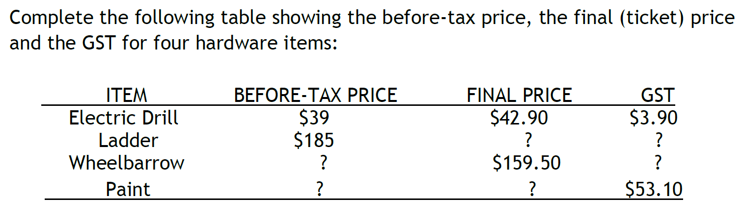
Task

Slide 8
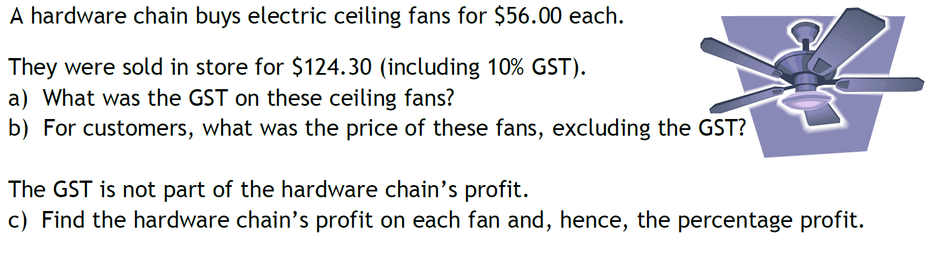
Task

Slide 9
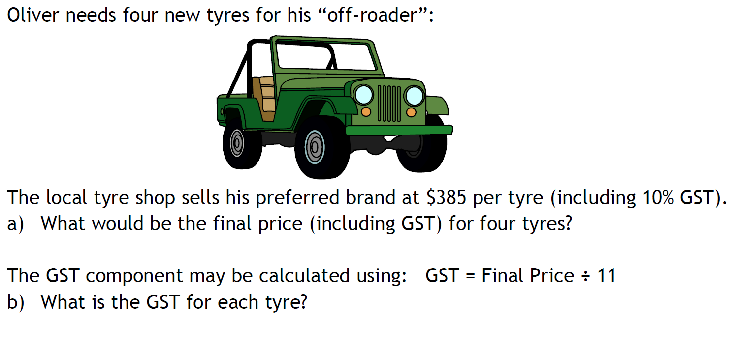
Task

